Slide 1
Question 1
In which one of the following scenarios would a skipper be committing an offence under the Tourism Authority Act 2006?
A operating a pleasure craft without a second person onboard to do lookout duties
B operating a pleasure craft not equipped with navigational lights during a moonlit night
C operating a pleasure craft at 27 knots in open seas when no other craft is in sight
D operating a pleasure craft at 21.5 nautical miles off the shore of Flic en Flac being holder of a Category B (up to 24 n.m from the coast)skipper’s licence

Slide 2
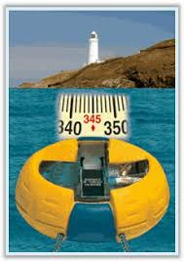
Question 2
When reporting the position of your craft at sea by the use of this magnetic compass, you need to mention the correct direction with respect to the lighthouse as
A 345 C
B 185 C
C 350 C
D 165 C

Slide 3
Question 3
‘Bilge’ of a vessel refers to
A the submerged part when afloat
B the lowest section inside the vessel which is closest to the keel
C the vertical height between the waterline and the keel
D the width of the weather deck

Slide 4
Question 4
How much distance will a pleasure craft cover in 1 h 15 minutes at a constant speed of 16 knots ?
A 12 nautical miles
B 16 nautical miles
C 20 nautical miles
D 24 nautical miles

Slide 5
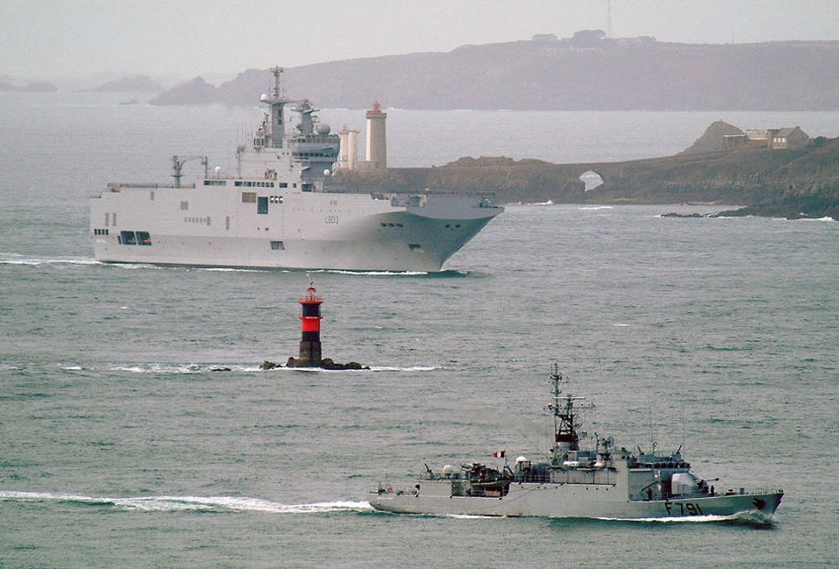
Question 5
How would you identify this navigational buoy by night?
A By its red and black bands
B By its position on the rocks
C By a series of six short flashes of red light
D By a series of two flashes of white light

Slide 6
Question 6
Your craft is on course 265◦C at night and at about 1 nautical mile ahead, you sight a buoy flashing white light continuously. You should therefore
A come to course to 205 ◦ C
B come to course to 325 ◦ C
C come to port by not more than 15 degrees
D keep well clear since it is an isolated danger buoy

Slide 7
Question 7
Which statement in respect of lookout duties at sea is FALSE?
A when alone onboard a craft at sea, the responsibility of maintaining lookout rests with the skipper
B a skipper is not relieved of his obligation to maintain lookout at night even though visibility is excellent
C a skipper should ensure that lookout is being maintained at all times by day and by night
D a skipper may stop maintaining visual lookout in restricted visibility if a radar is being operated

Slide 8
Question 8
‘Safe speed’ is a speed adopted by a skipper based on several factors. One of them is
A his age and experience
B the number of persons detailed for lookout duties
C the length of the craft
D the boat traffic density at any given time

Slide 9
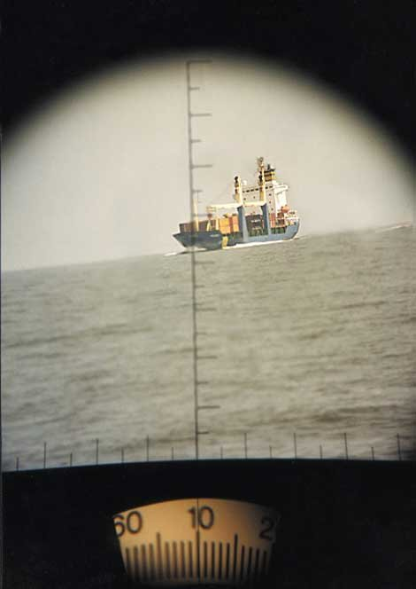
Question 9
A container vessel is off your starboard bow at a distance of 2 nautical miles. You take her bearing at 0910 and read 018 C. At 0916, you take a second bearing and read 010 C as shown below.
As a competent skipper, you know that
A you must alter course to port by at least 60 degrees
B the container vessel will pass ahead of you
C there is high risk of collision
D you must maintain your course and speed

Slide 10
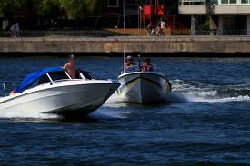
Question 10
These two power-driven pleasure craft are meeting in a crossing situation where collision is imminent. According to the Collision Regulations, which statement in this situation is TRUE?
A vessel P should alter course to port to avoid the collision
B vessel P may maintain her course and speed
C vessel Q should have altered course to port much earlier
D vessel Q should have altered course to starboard much earlier
Q
P

Slide 11
Question 11
You are operating a pleasure craft at 17 knots on high seas when suddenly the visibility reduces drastically. You come down in speed to 6 knots. What is the next action you would take in an order of priority?
A Plot a GPS fix on the chart
B Call all vessels on channel 16 and request their GPS positions
C Switch on navigational lights
D Switch on the radar

Slide 12
Question 12
You see this light at about 1 nautical off your port bow when you are on course 050 C.
As a competent skipper, you must
A maintain your course and speed
B come to course 350 C to keep well clear of her
C come to course 110 C to keep well clear of her
D call her on channel 16 to know her intentions

Slide 13

Question 13
Which statement is TRUE concerning this vessel ?
A she cannot deviate from her course because of her deep draught
B she is aground
C she cannot manoeuvre to avoid a collision because of the work she is doing
D she cannot manoeuvre to avoid a collision because of a technical problem

Slide 14
Question 14
You are nearing a bend in a harbour and because of buildings you cannot see whether there is traffic on the other side. You must therefore
A sound one prolonged blast
B sound at least five short and rapid blasts
C sound three short blasts
D sound one short blast

Slide 15
Question 15
The direction of ocean current around Mauritius is primarily
A Northerly
B Easterly
C North Westerly
D South Easterly

Slide 16
Question 16
Which statement concerning LOW PRESSURE areas is FALSE?
A wind blows counter-clockwise around the centre of a Low Pressure area in the Southern Hemisphere
B atmospheric pressure gradually increases when moving away from the centre of a Low Pressure area
C Low Pressure Areas are characterised by unstable weather conditions
D Continuous heating of a large body of seawater results in Low Pressure areas being formed

Slide 17
Question 17
A safety briefing by a skipper comprises various points. The primary aim of the briefing is to
A reassure the passengers that there are life jackets available onboard
B advise the passengers not to go on the weather deck without wearing a life jacket
C sensitize all the passengers that there always exists a certain degree of risk when being at sea but which can be reduced by complying with safety instructions
D guarantee all the passengers that the sortie will be incident- free based on his years of experience as skipper

Slide 18
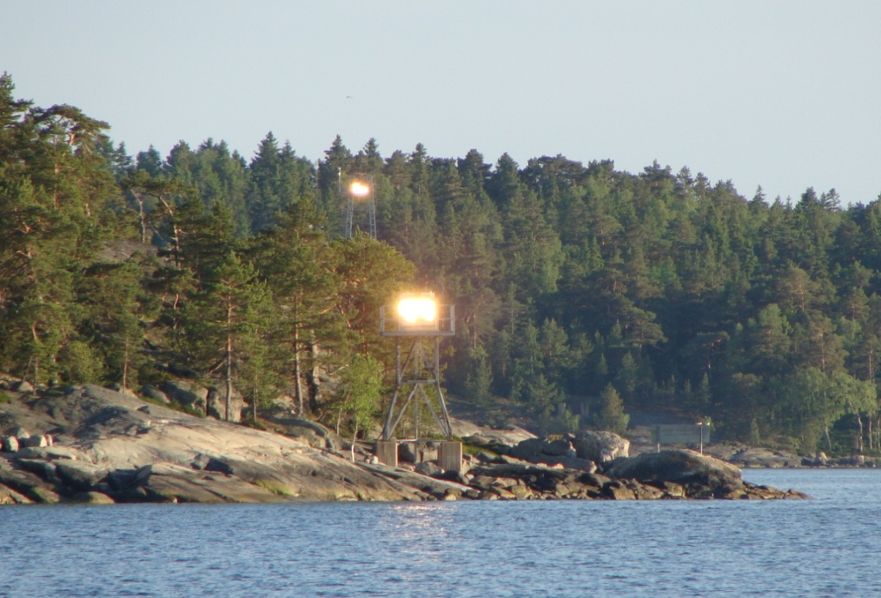
Question 18
Which statement is TRUE if you were leaving this bay for high seas by using these two marks in transit and a few minutes later the marks appear as shown below ?
A You must alter course to starboard to regain track
B Your vessel is starboard of track
C Your vessel is port of track
D You vessel is experiencing a slight drift towards port

Slide 19
Question 19
You are at sea off Port Louis Harbour and you hear a radio call starting with the words SECURITE SECURITE SECURITE. It means that what follows will be a message concerning
A a case of imminent danger to life
B a case where safety of navigation may be jeopardised
C a case of vessel incapacitated by engine failure
D a case of vessel carrying dangerous cargo

Slide 20
Question 20
You are the skipper of a power-driven vessel at sea with crew members and passengers onboard. You are in the wheel house and cannot see all around your vessel.Suddenly you hear “MAN OVERBOARD PORT SIDE”.Which one is the best sequence of actions to be taken to ensure quick and safe recovery of the person?
A alter course to starboard, order lifebuoy to be thrown, place a lookout
B alter course to port, call NCG on channel 16, make a williamson turn
C alter course to port, order lifebuoy to be thrown, place a lookout
D alter course to starboard, press the MOB switch on GPS, place a lookout

